Slide 1
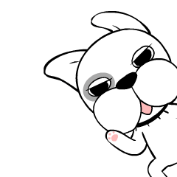

Slide 2
Raise your hands.

Slide 3
Put your hands down.

Slide 4
Take out your book.

Slide 5
Put away your book.

Slide 6
Open your book.

Slide 7
Close your book.

Slide 8
Come here, please.

Slide 9
Go back to your seat.

Slide 10
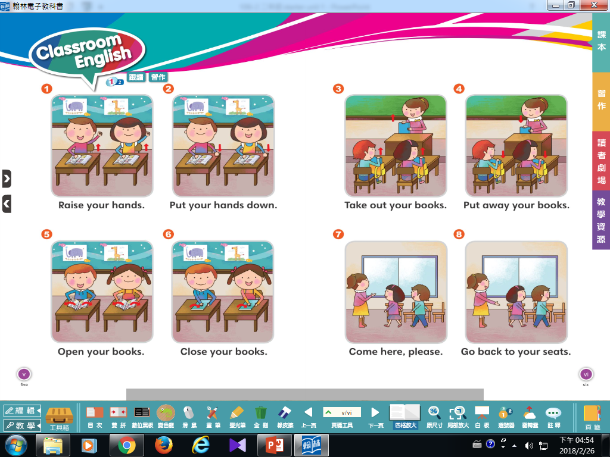

Slide 11
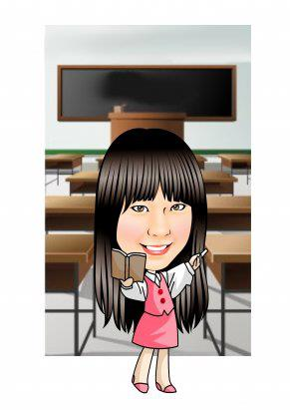
Look and guess.
Mandy says.
Whispering.

Slide 13
A~Z connection

Slide 15
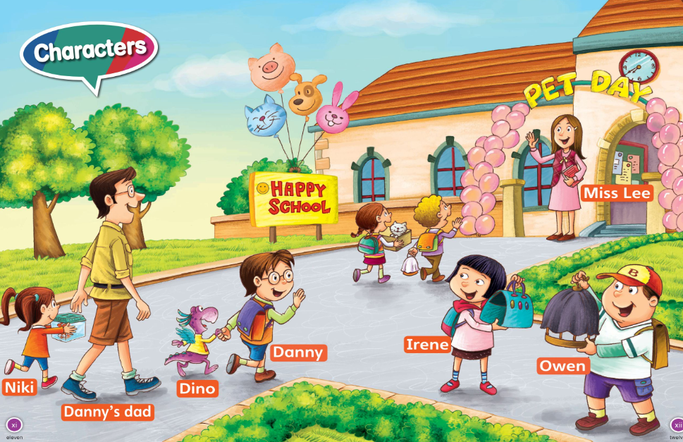

Slide 16
We are pets.

